Slide 1

Ashwath p Aviral Gupta Hrishikesh Gadekar Pratyush goel suyash khade
FUN FRIDAY – TEAM 4

Slide 2
ACTIVITIES
GUESS
THE
LOGO
place
MOVIE
GIBBERISH

Slide 3

LOGO QUIZ
Instructions:
We will display incomplete logos of brands(without names) and you have to guess.
If you know the answer for the question, Call out your team number and then answer.
40 seconds per logo . After 20 seconds if no one answers correctly, a hint will be given about the brand.
No negative points :-)

Slide 4

LOGO 1
Is answer needed !

Slide 5

LOGO 1
HINT: Taiwanese consumer electronics company

Slide 6

LOGO 1 → ANSWER

Slide 7

LOGO 2
HINT: Online database of information related to films, television programs, etc

Slide 8

LOGO 2 → ANSWER

Slide 9

LOGO 3
HINT: French luxury fashion house. Focuses on women's high fashion and ready-to-wear clothes, luxury goods and accessories.

Slide 10

LOGO 3 → ANSWER

Slide 11

LOGO 4
HINT: American telecommunications company

Slide 12

LOGO 4 → ANSWER

Slide 13

LOGO 5
HINT: American multinational retail corporation that operates a chain of hypermarkets

Slide 14

LOGO 5 → ANSWER

Slide 15
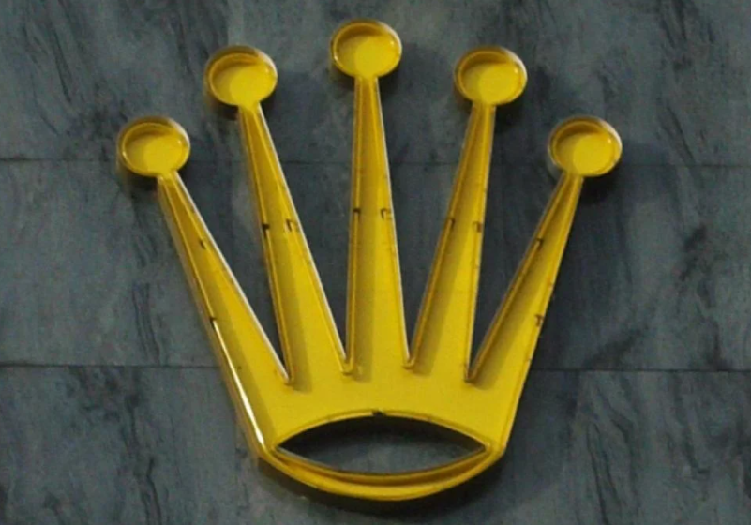
LOGO 6
HINT: luxury watch manufacturer

Slide 16

LOGO 6 → ANSWER

Slide 17

LOGO 7
HINT: Swiss chocolate bar brand

Slide 18

LOGO 7 → ANSWER

Slide 19

LOGO 8
HINT: American multinational corporation that designs, manufactures, and sells airplanes, rotorcraft, rockets, satellites

Slide 20

LOGO 8 → ANSWER

Slide 21
GUESS THE PLACE
Instructions:
We will display a picture of place(without names) and you have to guess.
If you know the answer for the question, Call out your team number and then answer.
40 seconds per picture. No hint in this round.
No negative points :-)

Slide 22
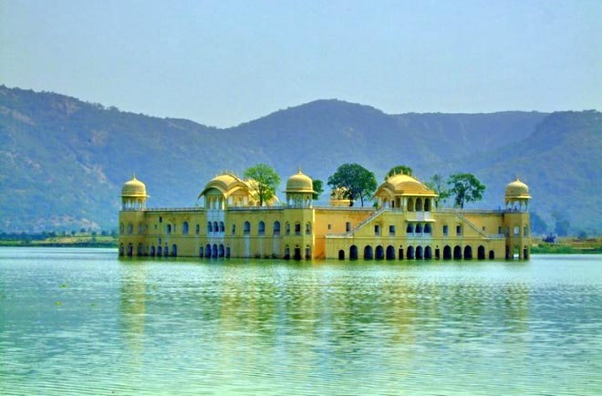
PLACE 1
jal mahal jaipur

Slide 23
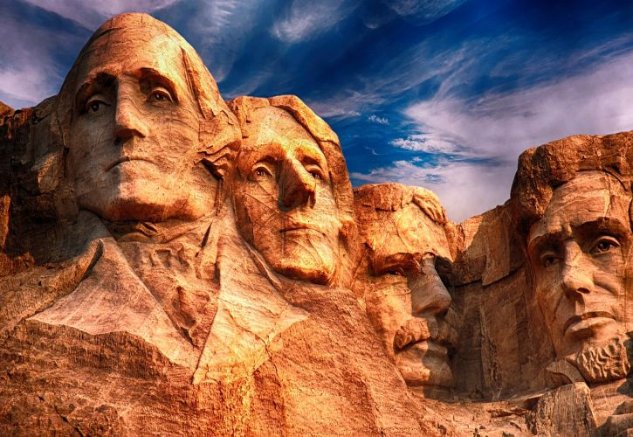
PLACE 2
Mount Rushmore (South Dakota)

Slide 24
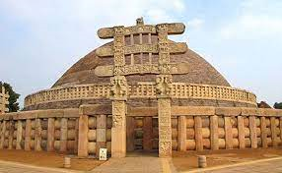
PLACE 3
Sanchi Stupa (Vidisha , MP)

Slide 25
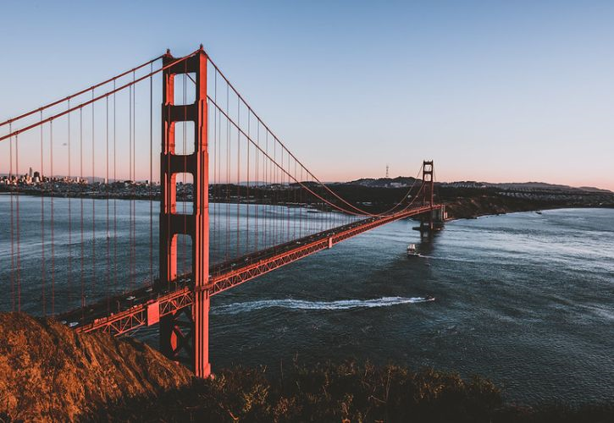
PLACE 4
Golden Gate bridge ,
San Francisco, California, USA

Slide 26
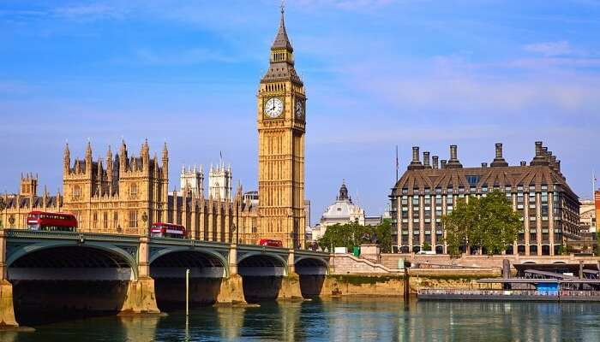
PLACE 5
Big ben,UK

Slide 27
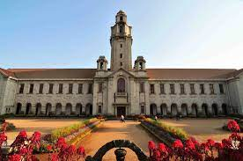
PLACE 6
IISC bangalore

Slide 28
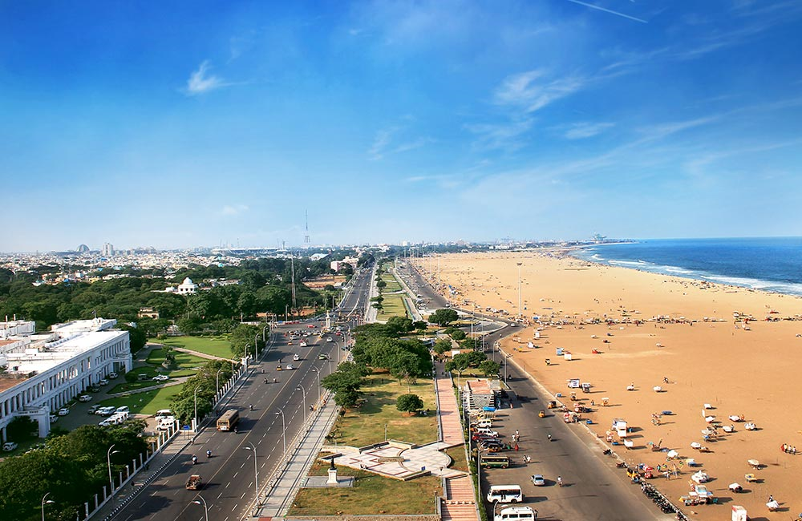
PLACE 7
Marina Beach, Chennai

Slide 29
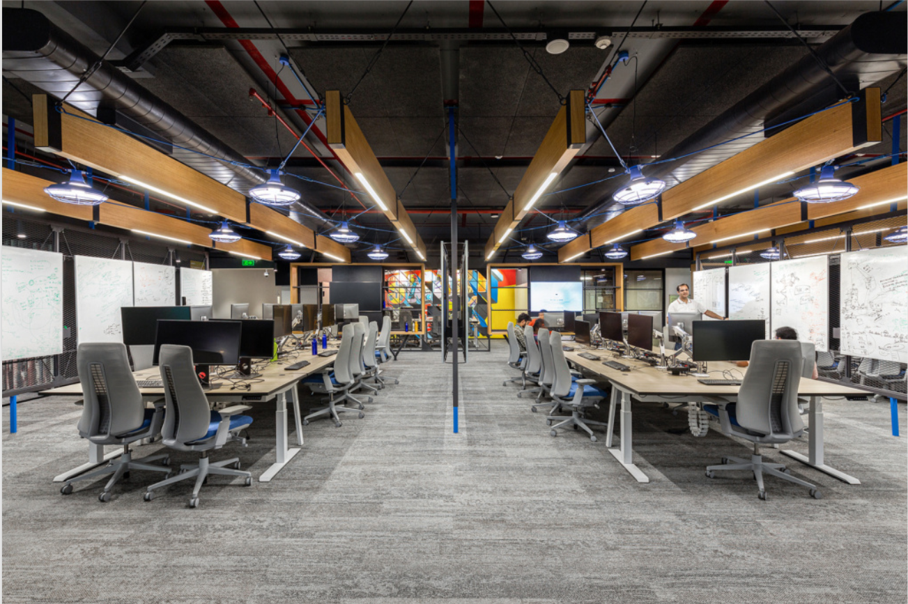
PLACE 8
Standard Chartered Office ,
Bangalore

Slide 30
GUESS THE MOVIE
Instructions:
We will display a video clip of a movie and you have to guess the full name of that movie.
If you know the answer for the question, Call out your team number and then answer.
No negative points :-)

Slide 31
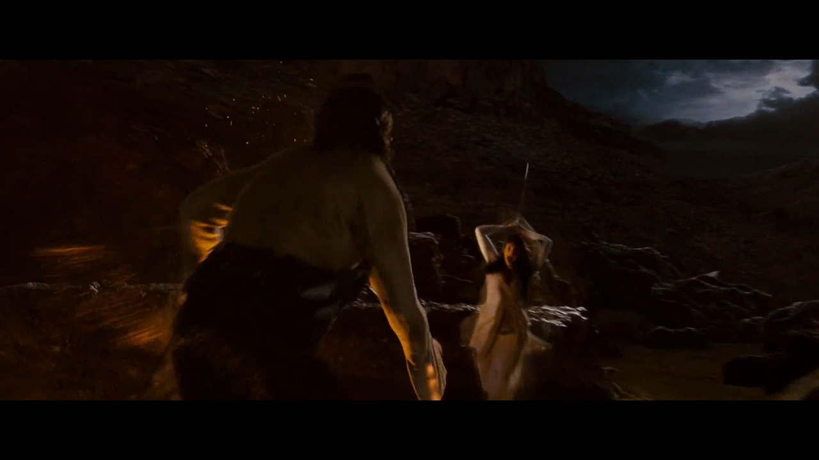
MOVIE 1
Prince of Persia: The Sands of Time

Slide 32
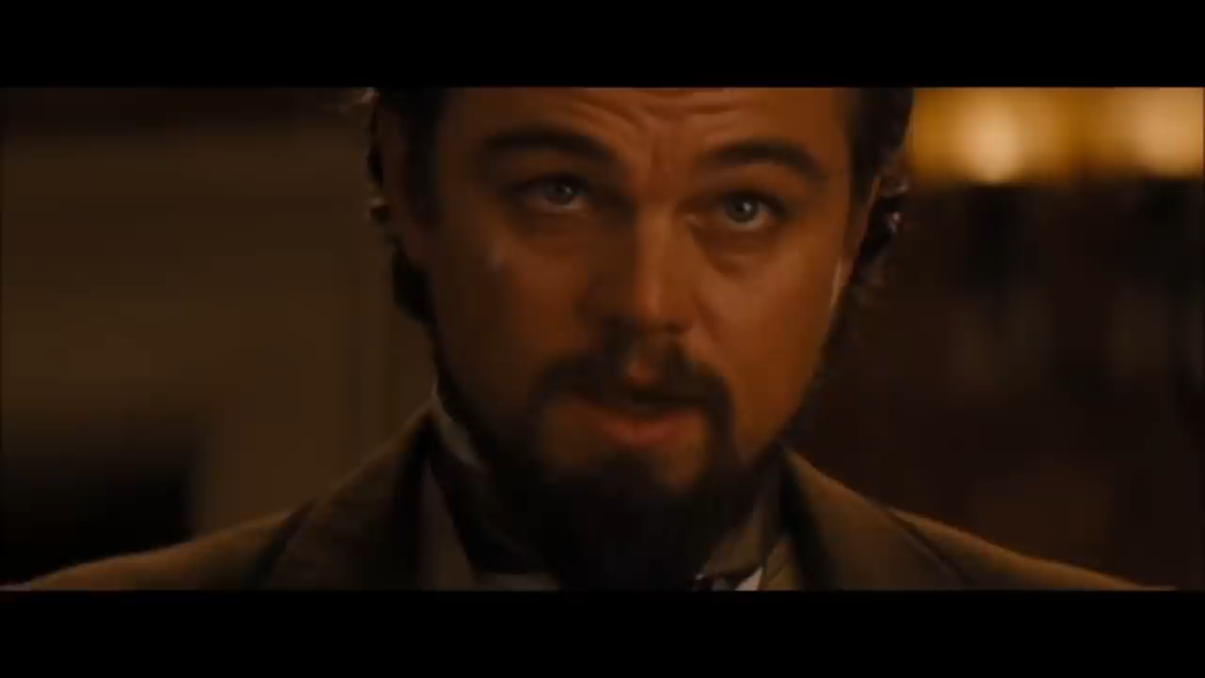
MOVIE 2
Django Unchained

Slide 33
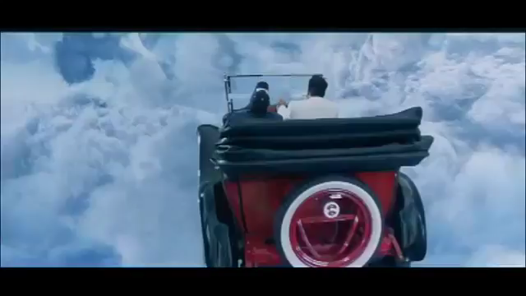
MOVIE 3
Vaah! Life Ho Toh Aisi!

Slide 34
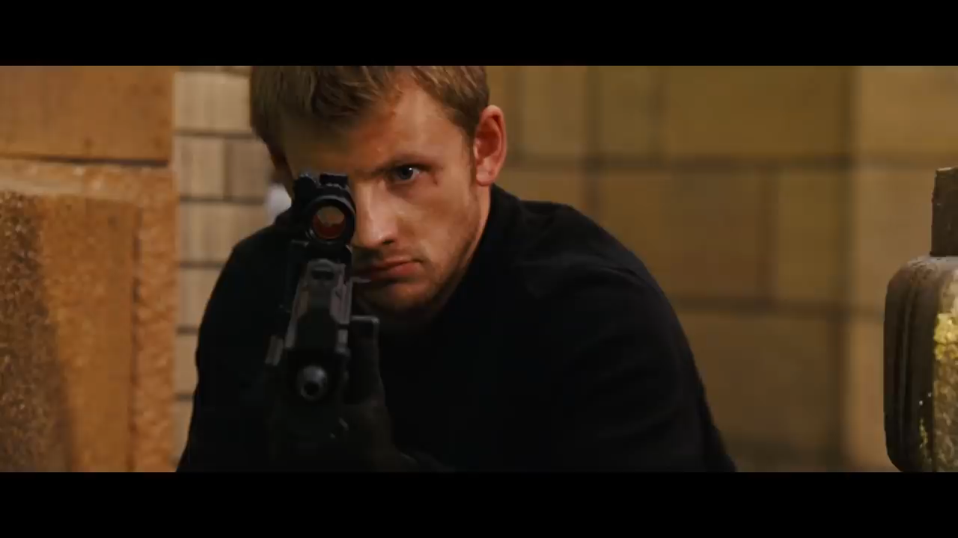
MOVIE 4
Wanted

Slide 35
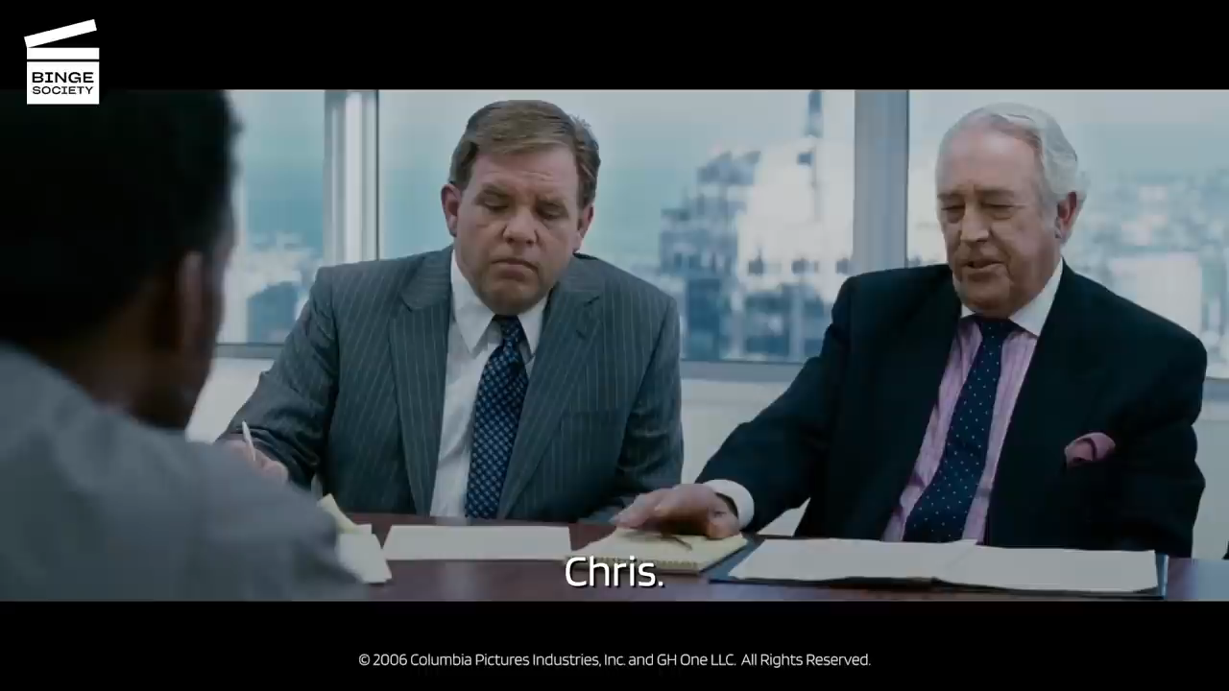
MOVIE 5
The Pursuit of Happiness

Slide 36

GUESS THE GIBBERISH
Instructions:
We will display a gibberish and you have to guess the original sentences.
Try to pronounce the words either fast or very fast. Ensure you are muted while doing so.
Each question will have a buffer time of 7 seconds. I'll start the Timer after the question is displayed.
Type in your Team number in the Chat as soon as you hear the alarm. E.g. TEAM 4 → T4.
Do not try to Google and spoil the fun. Just Enjoy.
It’s not about how it is spelled . . . it's about how it sounds!
No negative points :-)
Do not try to Google and spoil the fun. Just Enjoy.

Slide 37
GIBBERISH 1
BOE DAY TOTE SHIPS
Answer:- POTATO CHIPS

Slide 38
GIBBERISH 2
DAWN WAYS MIGHT I'M
Answer:- Don’t waste my time

Slide 39
GIBBERISH 3
EGGS HEARSE SIZED HAY LEE
Answer:- Exercise daily!

Slide 40
GIBBERISH 4
HIGHS CREEK OWN
Answer:- Ice cream cone

Slide 41
GIBBERISH 5
DOOR HER TEXT PULL HORROR
Answer:- Dora the Explorer

Slide 42
GIBBERISH 6
NOSE RING HER HATCHED
Answer:- No strings attached

Slide 43
GIBBERISH 7
WEED HID DENTS TART THIEF HIGHER
Answer:- We didn't start the fire

Slide 44
GIBBERISH 8
FISH HITS BIN HERS
Answer:- Fidget spinners

Slide 45
GIBBERISH 9
ACE SAY YEAR SEED DON THAN
Answer:- Easier said than done

Slide 46
GIBBERISH 10
ABE LESSON INDY SKIES
Answer:- A BLESSING IN DISGUISE

Slide 47
GIBBERISH 11
DISGUISE THEY'LL HIM IT
Answer:- The Sky is the Limit

Slide 48
GIBBERISH 12
WISE HOSE HEAR HE US
Answer:- Why SO SERIOUS?

Slide 49
GIBBERISH 13
CL IT A DE
Answer:- CALL IT A DAY!

Slide 50



